Slide 1
LLM-Driven Synthetic Data Generation for API Testing
Raguraman T
2023AA05528
BITS Pilani

Slide 2
Objective
Build an LLM-based tool:
Uses data schema as context. Ex, Json-schema, Open Api specification
Accepts natural language prompts
Generates accurate, schema-compliant test data

Slide 3
Proposed Solution
Use LLMs to understand:
Schema structure
User prompts
Generate test data through:
Prompt engineering
Context-aware synthesis

Slide 4
Implementation Overview
Data:
Hand crafted
De-identified production data
Model layer:
LLM-based prompt processing
Fine tuning if needed to achieve domain specific data generation
Interface:
API + Chat UI for user interaction
API + System integration

Slide 5
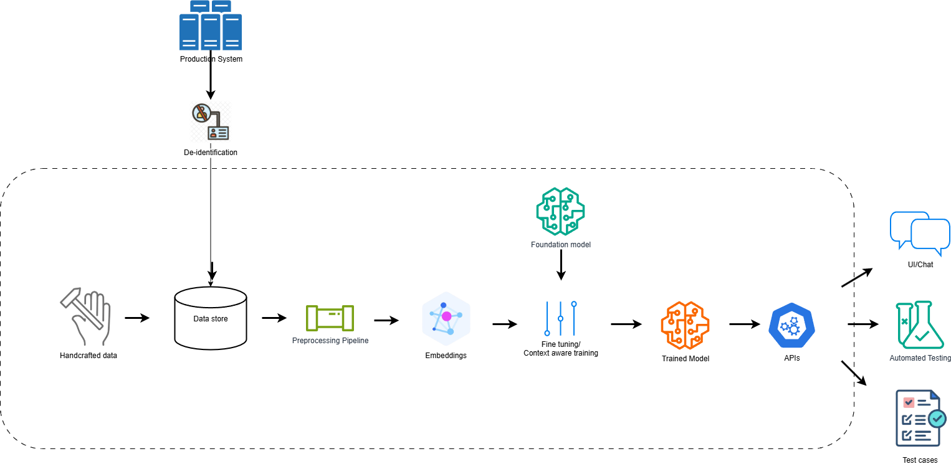
Implementation Overview

Slide 6
Status
Task | Status
Abstract submission | Complete
Research | Complete
Model and technology selection | Complete
Dataset preparation | Complete
Training | In-Progress
Evaluation | Pending
Deployment | Pending
Documentation and final report | Pending

Slide 7
Foundation Model
Mistral 7B Instruct tuned

Slide 8
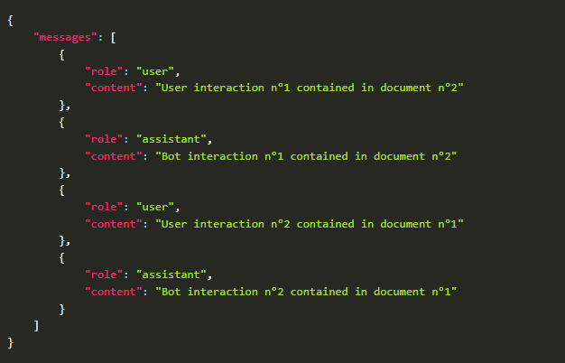
Dataset
Model specific chat style dataset

Slide 9
Dataset
Chat template
<s>[INST] Context: json schema goes here.\nUser: Hello, generate a sample data for the given schema [/INST] Expected json data goes here</s>

Slide 10
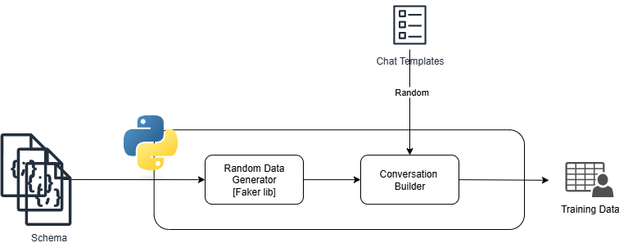
Dataset - Preparation
Python Code
Faker Library
Random data generation

Slide 11
Training
Huggingface framework
PEFT – LoRA/QLoRA Fine tuning
Local training at present and will use cloud services if needed

Slide 12
Evaluation
Goal:
Syntactic correctness,
Semantic accuracy
Field-level fidelity of the generated JSON

Slide 13
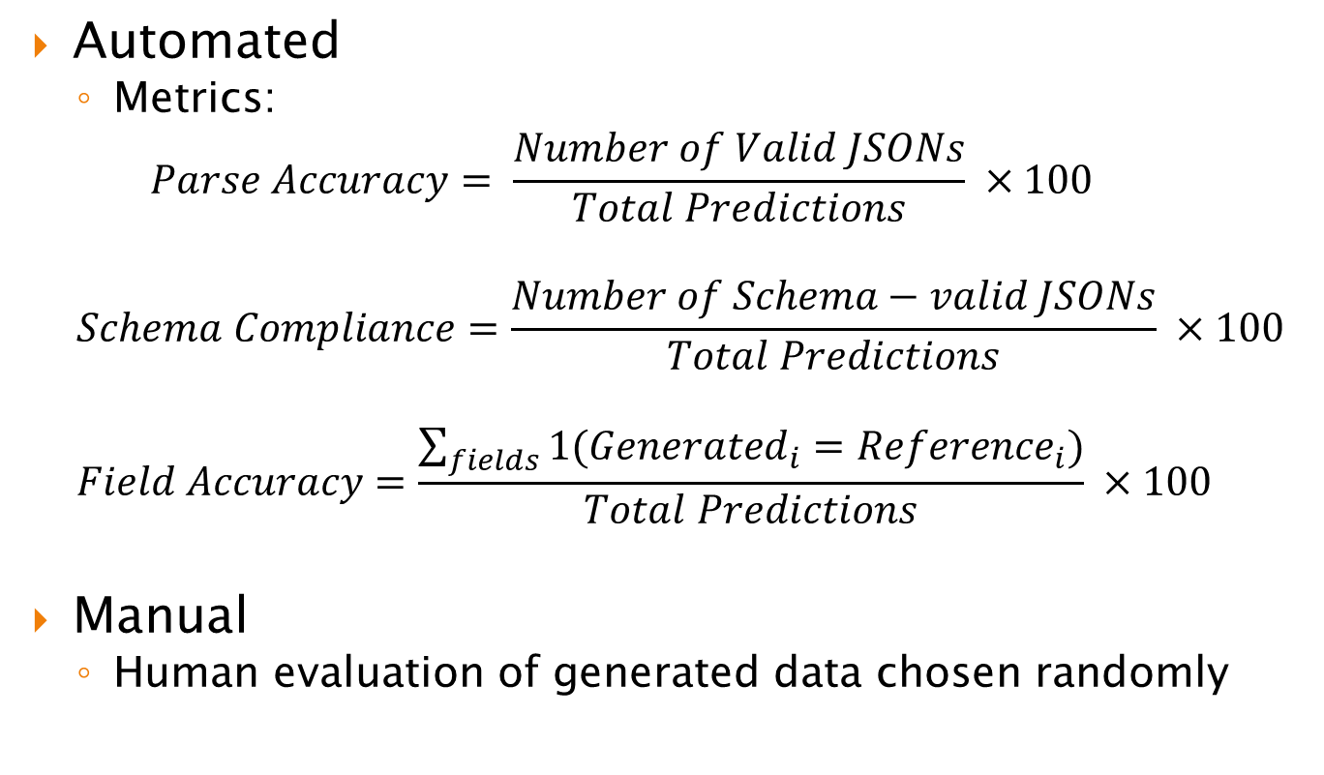
Evaluation Methods
Automated
Metrics:
$$Parse Accuracy= \frac{Number of Valid JSONs}{Total Predictions} ×100$$
$$Schema Compliance=\frac{Number of Schema−valid JSONs}{Total Predictions} ×100$$
$$Field Accuracy=\frac{\sum_{fields}{1({Generated}_{i}={Reference}_{i})}}{Total Predictions} ×100$$
Manual
Human evaluation of generated data chosen randomly

Slide 14
Next Steps
Training continuation
Evaluation and re-training
Hosting and demo

Slide 15
Q&A

